Slide 1
Business Connectivity Services
Creating composites using backend data sources
Notes:
Microsoft first introduced the concept of the Business Data Catalog (BDC) in SharePoint 2007 to consume data from external sources. In SharePoint 2010 Microsoft improved on this platform by introducing Business Connectivity Services (BCS). BCS adds the ability to read/write data to external systems as well as expand on the available data sources by adding a new concept: the .NET Assembly Connector. In this module you’ll learn how to consume and interact with external data sources as well as how to create a custom .NET Assembly Connector.

Slide 2
Agenda
Overview and Architecture of Business Connectivity Services (BCS)
External Content Types
Using External Content Types
Performance & Security
BCS Tooling (SPD2010 & VS2010)

Slide 3
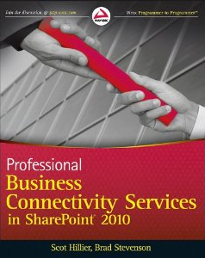
Module Companion
Professional Business Connectivity Services in SharePoint 2010 by WROX
Authors: Scot Hillier & Brad Stevenson
Course module can only cover so much in the available time
Looking for the deepest discussion around BCS?
Written by the SharePoint 2010 BCS Program Manager (Brad) & leading BCS expert (Scot) who’s also a CPT instructor!
Notes:
Available on Amazon!
http://www.amazon.com/Professional-Business-Connectivity-SharePoint-Programmer/dp/047061790X

Slide 4
Business Connectivity Services
Bring data from external systems into SharePoint and Office, interact with it, reuse it, and empower end users to gain insight into the underlying data in a reusable way.
Extend the reach of Enterprise Data
Centrally manage reusable connections
Easily create custom solutions
Notes:
Systems such as customer relationship management (CRM) and enterprise resource planning (ERP) have special roles that are not replaced easily by Microsoft SharePoint. As a result, strategies must be adopted to provide interoperability between SharePoint and these systems.In the absence of a strategy for integrating systems with SharePoint, many organizations duplicate information in SharePoint lists. Customer contact information, for example, may exist in a CRM system and also be entered into a contact list in SharePoint. Worse still, the data may be duplicated many times in different team sites by different groups. This kind of duplication leads to significant data maintenance issues because updates must be performed in many lists.
Along with these existing systems, custom applications, databases, and Web services are common within organizations. When a separate database is required, developers have historically created ASP.NET applications or custom Web Parts that act as front ends for the database to have the data appear in the SharePoint environment. However, these types of solutions generally offer little integration with SharePoint capabilities; they are largely limited to presenting data within a SharePoint Web page.
Business Connectivity Services (BCS) changes all the rules for integrating systems, databases, and Web services with SharePoint. Beyond simply bringing data into SharePoint for display, BCS allows for capabilities that simply can’t exist in an ASP.NET application or custom Web Part without a significant investment. These capabilities include enterprise search, External Data columns, user profile integration, client synchronization, offline support, and Microsoft Word integration.BCS is a set of out-of-box features, services and tools that streamline the creation of SharePoint Solutions with deep integration of External Data and Services. Power users, IT, Devs can create no code solutions using BCS.The basics of ECT store and BDC runtime are baked into SharePoint Foundation 2010.
Why BCS?
Integrate other Line of Business application systems with SharePoint sites.
Search for data in other systems via the SharePoint Search service.
Save the time, cost, and monotony of writing yet another data layer!

Slide 5
BCS Terminology
Business Data Connectivity (BDC): Service app controlling plumbing, runtime, connectivity
External System: Data source BCS can talk to
External Content Type (ECT): Definition of fields & operations to connect to external system
External Data: Data that resides in external sys.
External List: List based on external data
External Data Column: List column whose source is external data
External Data Web Part: OOTB Web Parts that display external data

Slide 6
SharePoint Licensing & BCS Capabilities
SharePoint Foundation 2010
BDC Runtime OM
SharePoint Server 2010 Standard
Secure Store Service OM
SharePoint Server 2010 Enterprise
External Data Search
Connectors
BDC Metadata Store
External Lists
External Data Columns
BDC Admin Pages
BDC Admin OM
Workflow
Administration Pages
Profile Pages
External Data Web Parts
Rich Client Extensions
InfoPath Forms
Notes:
SharePoint 2007’s external data story consisted of the Business Data Catalog (BDC) that was limited to read-only operations on the external system and was only available in the most expensive SharePoint license: Office SharePoint Server 2007 Enterprise.
SharePoint 2010 changes this by not only building off the BDC platform to provide a much more full featured external data offering with BCS, but it moves the bulk of the capabilities down to the free version of SharePoint, SharePoint Foundation 2010.

Slide 7



What Kind of Solutions Does BCS Enable?
Custom connectivity for data aggregation, transformation, security, etc.
Use custom code to integrate data into any Office app
Business logic in forms
Create reusable components (UI parts, ECTs, actions)
Customize
InfoPath forms
Workflow
Web Part Pages
Outlook task pane and ribbon
Out-of-box
Surface data in External Lists
Connect those lists to Outlook, SharePoint Workspace
External Data Columns
Simple
Intermediate
Advanced
NO CODE*
CODE
SharePoint Designer 2010
SharePoint SDK
Visual
Studio 2010
Power User
Developer
Advanced Developer
Notes:
No code – power users using SPD and using samples from SDK, using XML, to modify how the data would be presented in Outlook.
Create solutions in code and make the components available to the power users.
Simple and Intermediate – SPD. Intermediate needs some XML as well.
Advanced solution – Create reusable components that can later be used by power users in SharePoint Designer.

Slide 8
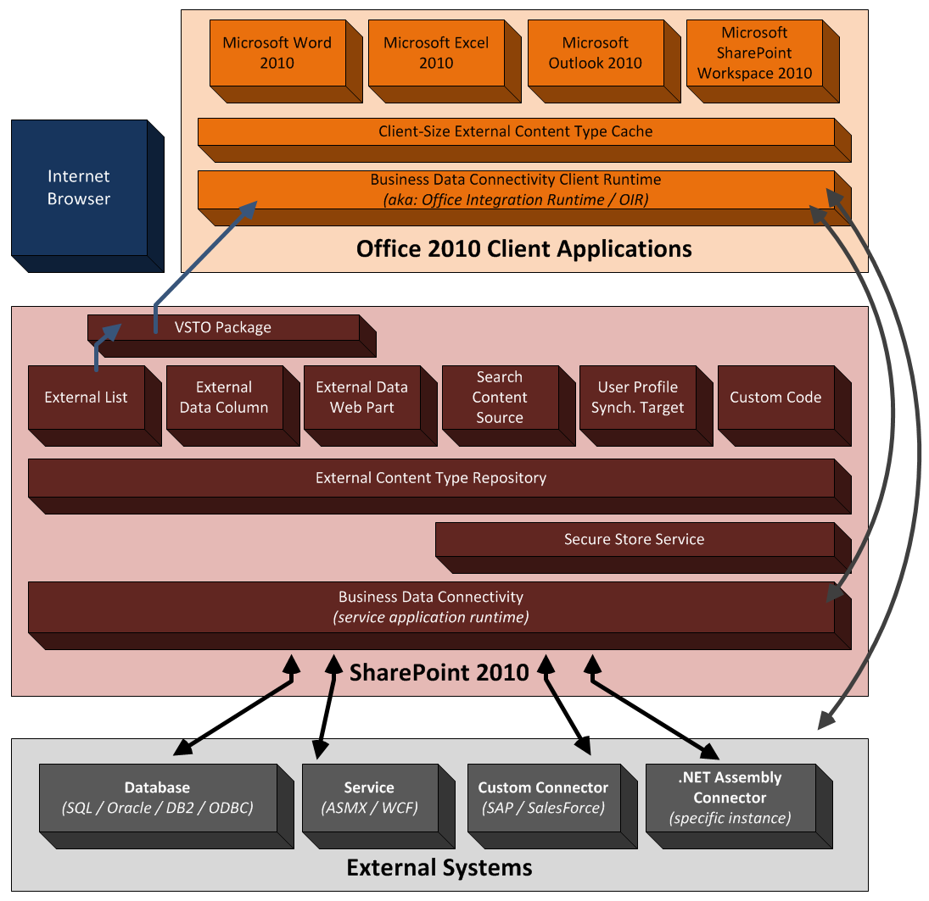
BCS Architecture

Slide 9
Agenda
Overview and Architecture of Business Connectivity Services (BCS)
External Content Types
Using External Content Types
Performance & Security
BCS Tooling (SPD2010 & VS2010)

Slide 10
External Content Types
Describe the schema of external data source
Describes CRUD operations on external data
Creating External Content Types:
SharePoint Designer 2010
Visual Studio 2010
Can export/import external content types via the Business Data Connectivity service application
Notes:
ECTs define fields, operations, and filters to be used with the External Data and are the heart of the BCS infrastructure. As an example, consider a manufacturing database that contains product information.
An ECT named Product can be created that defines ProductID, ProductName, and ProductDescription fields. Furthermore, it might define operations for retrieving data based on a keyword query or exact product identifier. Defining ECTs is one of the primary activities involved in creating a BCS solution and may be performed in either Microsoft SharePoint Designer 2010 (SPD) or Microsoft Visual Studio 2010 (VS2010). ECTs are stored in a metadata catalog, which is part of the BDC Service Application and is available throughout the SharePoint farm

Slide 11
External Content Type Operators
ECTs support multiple types of operations on external systems (some supported in SPD2010)
Operator | SPD 2010 Supported?
Finder
SpecificFinder
IdEnumerator
Scalar
AccessChecker
Creator
Updater
Deleter
ChangedIdEnumerator
DeletedIdEnumerator
Operator | SPD 2010 Supported?
AssociationNavigator
Associator
Disassociator
GenericInvoker
StreamAccessor
BinarySecurityDescriptor Accessor
BulkSpecificFinder
BulkAssociatedIdEnumerator
BulkAssociationNavigator
BulkIdEnumerator
Notes:
BCS supports a wide variety of operations designed to facilitate accessing systems and performing CRUD functions. Generally, you will be concerned with basic reading and writing to External Systems using Finder (Read List), SpecificFinder (Read Item), Creator (Create), Updater (Update), and Deleter (Delete) methods. These methods are also supported in SPD through menus in the Operations Design view. Methods that are not supported by SPD offer additional functionality and control, but they must be created by manually editing the BDC Metadata Model or creating a .NET Assembly Connector. Manually editing the XML model requires that you export the model, edit it, and import the new model. The remaining filters can be defined by manually editing the XML in the model. The following list details all available operators:
Finder: Returns multiple records from an External System based on a wildcard
SpecificFinder: Returns a single record from an External System based on a primary key
IdEnumerator: Returns all primary keys from an External System to support search indexing
Scalar: Returns a scalar value from an External System
AccessChecker: Checks to see what rights are allowed for a user
Creator: Creates a new record in an External System
Updater: Updates an existing record in an External System
Deleter: Deletes a record in an External System
ChangedIdEnumerator: Returns primary keys for records that have changed to support incremental search indexing
DeletedIdEnumerator: Returns primary keys for records that have been deleted to support incremental search indexing
AssociationNavigator: Navigates from one entity to a related entity
Associator: Associates an entity with another entity
Disassociator: Disassociated one entity from another
GenericInvoker: Used to perform operations not supported by any of the defined operations
StreamAccessor: Supports accessing BLOB data from an External System
BinarySecurityDescriptorAccessor: Returns a security descriptor
BulkSpecificFinder: Returns a set of records from the External System in a batch based on a set of primary keys
BulkAssociatedIdEnumerator: Returns a set of primary keys representing records associated with an entity
BulkAssociationNavigator: Supports navigation from one entity to many related entities
BulkIdEnumerator: Returns all primary keys in a batch from an External System to support search indexing

Slide 12
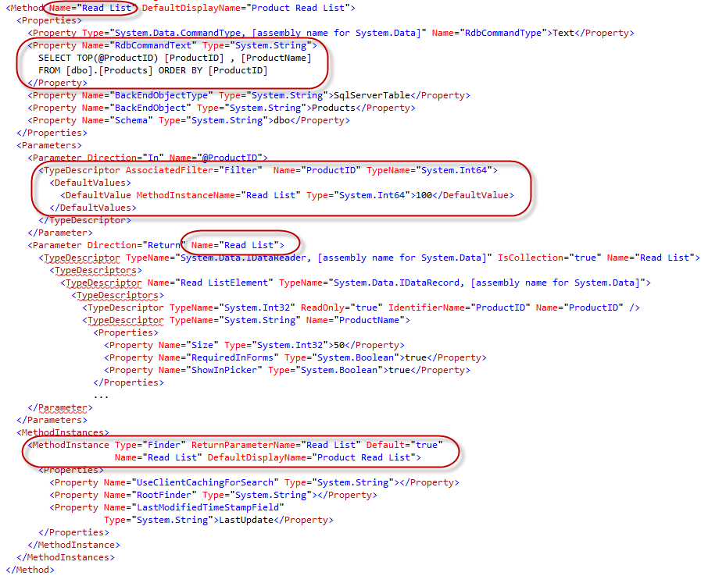
Notes:
This slide shows a sample Finder method as represented in XML for the model.

Slide 13
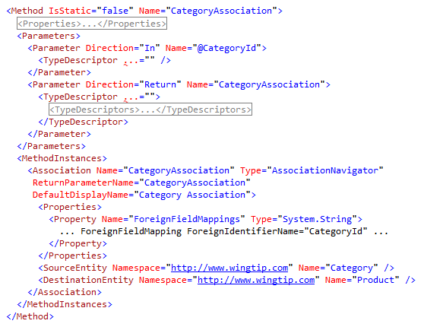
ECT Entity Relationships
Entities can have relationships with other entities
Options:
1:MANY
Self-referential
Reverse
Can be created in SPD2010 and further customized in the XML model
Notes:
BCS supports the definition of relationships between entities, which allows you to display relationships and navigate between entities within SharePoint. Within the SharePoint Designer, one-to-many, self-referential, and reverse associations are supported by the tooling. The most common type of association in BCS solutions is the one-to-many association, whereby a parent entity instance is related to many child entity instances. Self-referential associations are just like one-to-many relationships, except that a self-referential relationship uses the same ECT as both the parent and the child. Reverse associations return a single parent entity instance for a child entity instance. Reverse associations are not supported for tables and views, but they are supported for stored procedures and Web services because the reverse association is not inherent in the database schema. It must be programmed explicitly through a stored procedure or Web service.
The XML snippet shows a relationship between a Product entity and a Category entity.

Slide 14
Agenda
Overview and Architecture of Business Connectivity Services (BCS)
External Content Types
Using External Content Types
Performance & Security
BCS Tooling (SPD2010 & VS2010)

Slide 15
External Lists
Expose external data as a native SharePoint list
Full CRUD-Q capability w/ familiar UI & navigation
Forms can be converted to InfoPath forms
Profile page available for each item in the list
Access via SharePoint object model (SPList)
Some differences from traditional SP lists
Because SharePoint doesn’t “own” the data, some standard list functionality is not available with external lists
Notes:
External Lists can be created directly in SPD or in the browser using the Create menu in SharePoint. Once the new External List is created, it may be viewed in the browser. Because all the CRUDoperations were created, the resulting list supports editing, adding, and deleting items. The appearance of the External List closely resembles a standard SharePoint list. The Ribbon is functional, as well as the editcontrol block (ECB) associated with individual items. Any changes to items in the list will be reflected immediately in the External System. Just like “regular“ lists, External Lists may be taken offline through both the SharePoint Workspace 2010 and Outlook 2010.
While External Lists appear similar visually to standard SharePoint lists and are supported by a SPList object, they do have significant limitations that must be considered in any design. These limitations include lack of workflow support and several standard list features. The following lists some of the major limitations of External Lists.
Approval: Approval of items is not supported
Attachments: Attachments are not supported directly, but must be implemented using a StreamAccessor operation in a custom solution
Check-in/Check-out: Check-in and checkout of items are not supported
Content Types: Using standard site content types in External Lists is not supported
Drafts: Drafts of items are not supported
ECB: Send-To operations are not supported
Events: List event handlers are not supported
Ribbon: Datasheet View is not supported
SPLINQ: Querying through LINQ to SharePoint is not supported
Templates: Document templates are not supported
Versioning: Versioning of items is not supported
Workflow: Starting workflows from items is not supported, but workflows can read or write to External Lists through the SPList object
Validation: Validation formulas are not supported

Slide 16
Surfacing External Data
External Data Columns
Add data from external content types to standard SharePoint lists
Can be made available as Content Controls in Word
Web Parts
External Data Item
External Data List
External Data Related List
External Data Item Builder
Chart Web Part
Profile Page
External Data Search
Integrate External Data into search results
Notes:
External Data Columns:
Along with using an ECT as the basis for a list, you can use an ECT as the source for a column in another list. This capability is known as an External Data Column. When you create an External Data Column for a list, you select the ECT to use as the basis for the column. You may then select one or more of the fields available in the ECT to display alongside the column you are creating. These additional fields are known as projected fields because they project data from the ECT into the parent list.
BCS Web Parts:
Another way you can use ECTs is through a set of Web Parts that ship with SharePoint Server 2010 known as External Data Web Parts (also called Business Data Web Parts). External Data Web Parts are designed specifically to display ECT data and relationships. The available parts include the Business Data List, Business Data Related List, and Business Data Item. These Web Parts display a list based on an ECT, a list based on an ECT association, or a single item, respectively.
Business Data Item: Displays details for a single external item
Business Data List: Displays list of external items
Business Data Related List: Displays a list of external items related to an item passed as input (typically selected in the Item or List web part)
Business Data Actions: Displays a list of actions for the selected external item
Business Data Item Builder: Retrieves input parameters from the URL/query string and passes them to parts on the page. This Web Part is not visible when the page is not in edit mode
Profile Page:
When SharePoint surfaces ECT data in lists and Web Parts, it does not necessarily show all the available fields and associations. For example, when an ECT is used as the source for an external column, only a single field is required for display. When users see partial ECT data, however, they are quite often interested in being able to see the data behind it. This is where profile pages enter the picture. A profile page is a dedicated page that shows all the ECT data for a specific record. This way, users can jump from partial ECT data to a complete view of the record.
External Data Search:
ECTs created with SPD already support indexing by SharePoint Search with no additional work. However, External Systems will be indexed only if you explicitly set up a content source that includes the ECT. Content sources can be created within the Search service application, where you will have the option to create a content source associated with an External System.

Slide 17
Demo
Modeling External Content Types

Slide 18
Agenda
Overview and Architecture of Business Connectivity Services (BCS)
External Content Types
Using External Content Types
Performance & Security
BCS Tooling (SPD2010 & VS2010)

Slide 19
BDC Throttling & ECT Filters
BDC service application manages performance via throttle settings
Individual ECT Finder & SpecificFinder methods can also implement filters to limit the amount of data each returns
Type | Scope | Default | Max
Connections | Global | 100 | 500
Items | Database | 2000 | 25,000
Timeout | Database | 60 sec | 600 sec
Size | Service | 3 MB | 150 MB
Timeout | Service | 60 sec | 600 sec
Notes:
BCS implements limits on the number of connections that can be made to an External System. In addition, the BDC service application also implements five different throttle settings to limit the connections made and data returned from External Systems. The different types of throttle settings for the BDC service application are as follows:
Connections (global): Total number of connections allowed to External Systems
Database
Items: Number of rows returned from a database query
Timeout: Database connection timeout
Web Service (ASMX / WCF)
Size: Size of returned data
Timeout: Web service connection timeout
Throttle values can be viewed and changed using Windows PowerShell commands. Before you can change them, however, you must get a reference to the BDC service application. Exercise great care if you elect to change the throttle settings.

Slide 20
External Content Type Filters
Some filters supported by SPD2010 wizards
Others specified in application model (XML)
Filter | SPD2010 Supported?
ActivityId
Batching
BatchingTermination
Comparison
Input
InputOutput
LastId
Limit
Output
Filter | SPD2010 Supported?
PageNumber
Password
SsoTicket
Timestamp
UserContext
UserCulture
Username
UserProfile
Wildcard
Notes:
The Application Model supports all these types of filters. Filters can also be thought of as input parameters to an ECT operation. Generally, their values are set by the calling client before the operation is invoked. The wizards in SPD will help you define the most common filters when you are creating ECTs. The available filters are as follows:
ActivityId: A globally unique identifier (GUID) representing the correlation Id of the current operation
Batching: Information about the current batch operation for filtering
BatchingTermination: Information about the current terminating batch operation for filtering
Comparison: Filters the records returned based on a value compared to a specific field
Input: Can be used by the operation as an input value when the operation is called.
InputOutput: Can be used by the operation as both an input and output value when the operation is called.
LastId: Identifies the Id of the last item in an operation
Limit: Limits the total number of records returned to a fixed amount. Not compatible with the PageNumber filter.
Output: Can be used by the operation as an output value when the operation is called.
PageNumber: Limits the records returned using paging. Not compatible with the Limit filter.
Password: The password for the current operation
SsoTicket: The ticket for use when authenticating
Timestamp: Filters the records returned based on a specified DateTime field
UserContext: Context information about the current user
UserCulture: The current user culture
Username: The current user name
UserProfile: Profile information about the current user for filtering returned results
Wildcard: Filters the records returned based on Starts With or Contains values
Whenever you are creating Finder and SpecificFinder methods, you should define a Limit filter for the operation. This filter ensures that large result sets are not returned to an External List and are critical for maintaining BCS performance. While BCS does implement throttling at the system level, the ECT should implement its own tighter limits to ensure query performance is maintained.
Defining filters in SPD is done in the Operation Wizard on the Filter Parameters Configuration page. On this page, you may click Add Filter Parameter to add a new filter. After adding a new filter, you must then click the Filter hyperlink to open the Filter Configuration dialog.

Slide 21

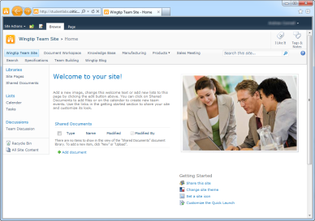
BCS Authentication & Authorization
Secure Store Service
Authentication
BDC Service Application
External Content Type Repository
Authorization
External List
Notes:
BCS security can be though of as breaking down into two different categories: authorization & authentication.
Authorization:
After creating an external content type, even if the user has rights to the underlying external data in the external system, the BDC service application runtime will deny access to the data. The reason for this is that each ECT in the External Content Type Repository has four types of permissions that can be applied to it. At a minimum the user requesting the data must have the Execute permission to execute methods defined in the ECT. Users can be granted access either by their specific account, membership to a group or even using claims.
Authentication:
Assuming the user requesting the external data is given access to the external data, they then need to be authenticated against the external system. There are three options for authentication covered later in the module.

Slide 22
BCS ECT Authorization Permissions
Available Permissions:
Edit: create, delete, update metadata objects
Execute: call external system (read)
Set Permissions: give permissions to other users
Selectable In Clients: accessible to clients applications like entity picker

Slide 23
BCS Authentication Overview
Popular Authentication Options | WCF Service Connector | Database Connector | .NET Assembly Connector
SQL Auth |  |  | Code-Based
UserName & Password |  |  | Code Based
NTLM Pass through
Claims Token |  |  | Code Based
OpenID / LiveID | Code Based |  | Code Based
Notes:
When connecting to back-end systems, BCS must deal with several different authentication scenarios. In the simplest case, BCS may be passing Windows credentials from the user through to the External System. However, most real-world applications have more complex requirements, such as proprietary authentication mechanisms, tokens, or claims. For BCS solutions to be secure, they must deal with these situations adequately.
BCS supports two authentication models: Trusted Subsystem and Impersonation and Delegation. In the Trusted Subsystem model, BCS uses a single account to access the External System regardless of the user identity. Under Impersonation and Delegation, BCS attempts to impersonate the user and access the External System. The AuthenticationMode element in the BDC Metadata Model determines how authentication is performed and has several different options.

Slide 24
Authentication Options
Passthrough Authentication
Used in Impersonation & Delegation authentication models
Not likely to be useful in many scenarios: double-hop
RevertToSelf Authentication
Used in Trusted Subsystem authentication model
Secure Store
Used in both Impersonation & Delegation and Trusted Subsystem authentication models
Map current user to shared/unique stored credentials
Claims Based Systems
Notes:
Passthrough Authentication:
Setting the value of the AuthenticationMode element to Passthrough causes BCS to use the credentials of the current user to access the External System. While Passthrough authentication is easy to implement, it is unlikely to be useful in many situations because of a particular limitation in Windows authentication known as the double-hop issue. Windows authentication takes two forms: NTLM and Kerberos. NTLM is the classic challenge-response protocol used to authenticate users. Kerberos is an advanced ticket-based protocol that is much more secure. NTLM authentication is often compared to a carnival where you must pay for each ride separately. Kerberos, on the other hand, is often compared to a theme park where you pay for one ticket and then have access to all the rides. While Kerberos authentication is considered to be a best practice for BCS, many organizations still run under NTLM authentication.
The double-hop issue describes a scenario under NTLM authentication where the Web server attempts to impersonate a user through a series of “hops” involving multiple servers. When a user makes a request to view an External List, SharePoint will attempt to impersonate the user. However, when BCS subsequently attempts to access the data source, it will be prevented from continuing to impersonate the user, and the account identity will change to that of the system account. At this point, the original user identity is lost and access to the data source will be denied.
RevertToSelf Authentication:
Setting the value of the AuthenticationMode element to RevertToSelf causes BCS to use the credentials of the application pool to access the External System. Using RevertToSelf authentication eliminates the double-hop issue because BCS is no longer attempting to impersonate the user all the way to the External System. The drawback to this approach, however, is that all access is accomplished using the same account. As a result, no auditing of individual activities against the External System is possible.
Secure Store:
If you map all user credentials to a single group account in SSS, then you can support the Trusted Subsystem authentication model. If you map user credentials to a unique set of credentials per user, then SSS is supporting the Impersonation and Delegation authentication model. SSS is a far superior choice to either Passthrough or RevertToSelf because you can configure access to External Systems such that auditing is still possible while still overcoming double-hop issues. SSS is capable of managing three types of credentials: Windows, SQL & username/password.
Claims Based Systems:
To implement claims authentication, the AuthenticationMode should be set to Passthrough. None of the other configuration really makes sense because claims authentication is based on delegating the user’s identity.

Slide 25
DEMO
Configuring ECT Authorization & Implementing External Lists

Slide 26
Agenda
Overview and Architecture of Business Connectivity Services (BCS)
External Content Types
Using External Content Types
Performance & Security
BCS Tooling (SPD2010 & VS2010)

Slide 27
SharePoint Designer 2010 vs. VS2010
SharePoint Designer 2010
Creating ECTs to external systems (databases / Web services)
Map operations for external systems
Reuse existing connections (custom connector)
Surface external data (external lists / Office clients)
Visual Studio 2010
Create .NET Assembly Connector
Aggregate data across multiple external systems
Customizable data transformations
Expand & extend SPD2010 created models
Create Custom Connectors
Notes:
Developers have two tools at their disposal in creating BCS solutions. SharePoint Designer 2010 is good for simple solutions that expose data from databases and Web services. While SPD2010 only supports designers for some operators, users can export the model as XML from the BDC service application and make manual edits to add additional operators. Visual Studio 2010 provides developers the ability to create custom connectors (for connecting to external systems such as PeopleSoft, SAP or SalesForce) or .NET Assembly Connectors (for connecting to specific instances of external systems).

Slide 28
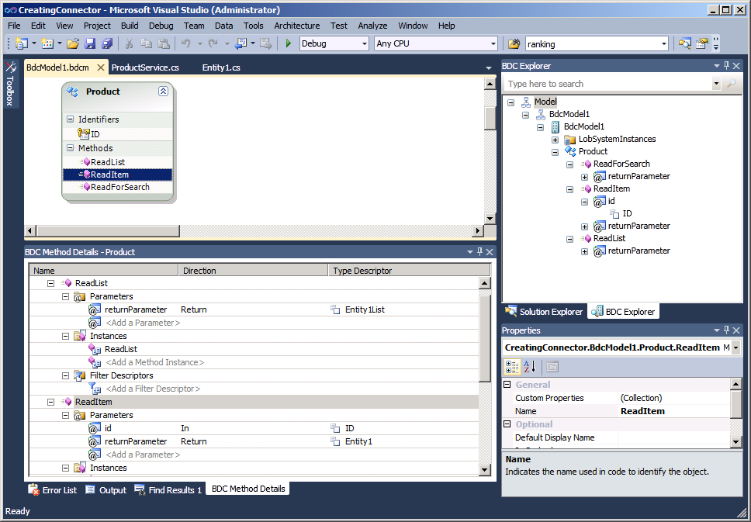
Visual Studio 2010 Support
Notes:
The Visual Studio 2010 Tools for SharePoint 2010 contain a project template for designing Business Data Connectivity models. It comes with a set of visual designers and code management that will let you author External Content Types.
Visual Studio 2010 BCS Designer allows you to develop, debug and deploy BDC models using the External System type .NET Assembly Connector. This type is used for:
Aggregation scenarios (across back-ends, across multiple calls to same backend, read from one back-end write to another)
Custom/Complex Data Transformations
Custom Security (e.g. where SSO falls short)
Custom Business Logic/Rules needed outside the back-end (don’t have good example of this)
In addition Visual Studio 2010 BCS designer allows to import models created by SPD and customize them, package them and deploy them through Visual Studio.

Slide 29
.NET Assembly Connector
Provides developers full control over all CRUD operators
Implemented via managed code
Enables developers to implement item-level security on external data
Not possible with SPD2010 generated external content types
Allows developers to create custom data transformations on the data as well

Slide 30
DEMO
Creating .NET Assembly Connectors

Slide 31
Summary
Overview and Architecture of Business Connectivity Services (BCS)
External Content Types
Using External Content Types
Performance & Security
BCS Tooling (SPD2010 & VS2010)

